Slide 1

Automated Measurement Of Fetal Head Circumference From Ultrasound Image
Capstone Project by
Niharika A Raj(23EE65R05)
Madhuri Wahane(23EE65R11)
Mary Surekha Sankuru(23EE65R24)
Signal Processing and Machine Learning
Dept of Electrical Engineering
Indian Institute of Technology Kharagpur

Slide 2
Contents
Introduction
Dataset
Model Architecture
Results
Conclusion
References

Slide 3
Introduction
Ultrasound imaging is pivotal in prenatal care due to its cost effectiveness, real-time functionality and non invasiveness
Crown-Rump Length (CRL) and Head Circumference (HC) measurements are crucial for estimating gestational age and monitoring fetal growth
Automated systems present a promising avenue for addressing the limitations associated with manual biometric measurement techniques

Slide 4
Introduction
This study endeavors to develop an algorithm capable of accurately estimating HC
Utilizes the U-Net architecture for segmentation to extract masks.
We employ Hough Transform for the ellipse parameter prediction.

Slide 5

Dataset
The dataset used for this challenge is available for download
from Zenodo, with the DOI 10.5281/zenodo.1322001
It comprises of training set of 999 ultrasound images and
testing dataset of 335 ultrasound images.
Dataset provides a diverse collection of pixel information
and manual annotation of head circumference
Ultrasound Image

Slide 6
Model Architecture
U Net
Edge
Detection
Hough
Transform

Slide 7
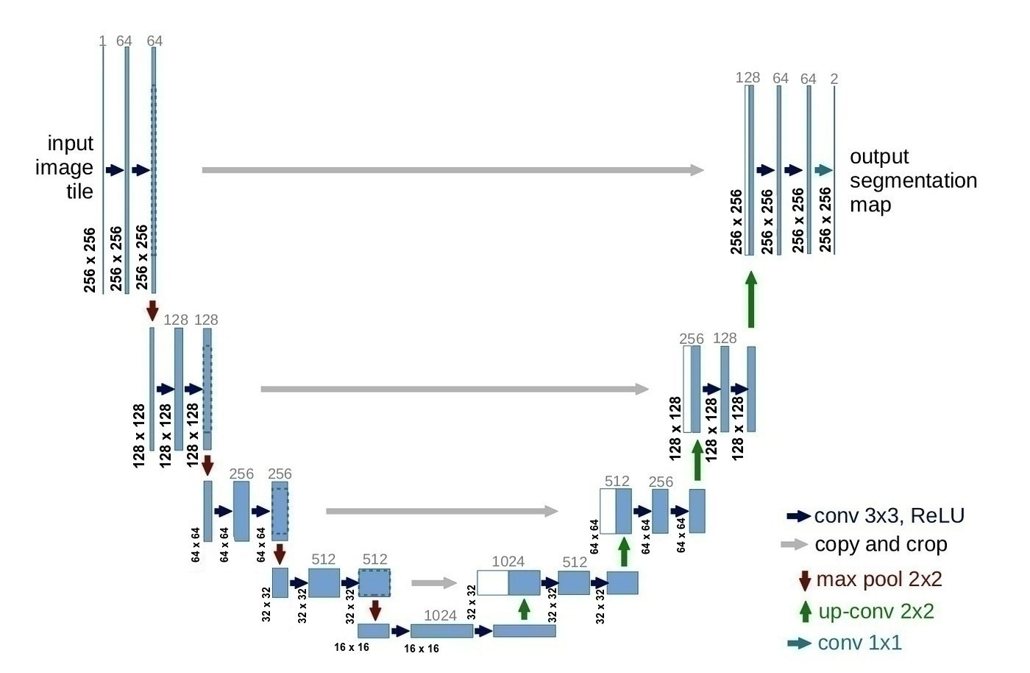
Unet Architecture
U Net
*U-Shaped Densely Connected Convolutions for Left Ventricle Segmentation from CMR Images

Slide 8
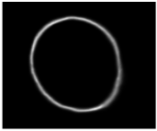

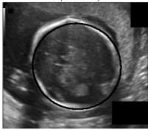
Canny Edge Detector
Smoothing with Gaussian blur.
Gradient calculation.
Non-maximum suppression.
Double thresholding and edge tracking.
Predicted mask
Binary Mask
Edge Detected
Overlay

Slide 9
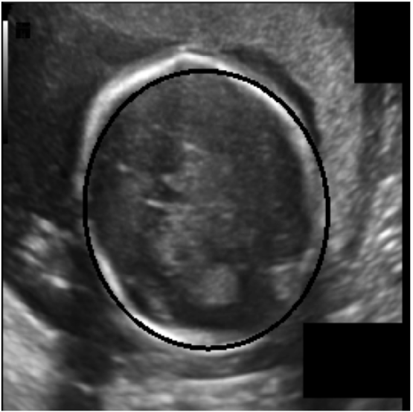
Hough Transform
Edge detection using techniques like Canny.
Voting for potential lines in the Hough space.
Thresholding and interpretation of peaks.
Ellipses detected by Hough Transform

Slide 10
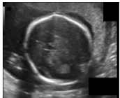
Results
Original Image
Predicted Mask

Slide 11
Results
Filled in Segmented masks with ellipses
Ellipses Boundary
Ellipses detected by Hough Transform

Slide 12
Evaluation
Metric | Maximum | Minimum | Mean | Standard Deviation
DICE Score | 99.68 | 89.12 | 97.70 | 1.32
Hausdorff Distance | 4.86 | 0.24 | 1.40 | 0.83
DICE Score (Trimester 1) | 99.08 | 89.12 | 96.45 | 2.25
DICE Score (Trimester 2) | 99.08 | 89.12 | 96.45 | 2.25
DICE Score (Trimester 3) | 99.34 | 95.61 | 97.65 | 0.83
Hausdorff Distance (Trimester 1) | 3.65 | 0.29 | 0.97 | 0.68
Hausdorff Distance (Trimester 2) | 4.21 | 0.24 | 1.28 | 0.64
Hausdorff Distance (Trimester 3) | 4.86 | 0.76 | 2.49 | 0.96

Slide 13
Conclusion
Automating the measurement of fetal Head Circumference (HC) from 2D ultrasound images, with a specific focus on advancing prenatal care is implemented
Overcoming the limitations associated with manual biometric measurement techniques
Advancement in maternal and fetal health outcomes

Slide 14
References
[1] Thomas L. A. van den Heuvel, Dagmar de Bruijn, Chris L. de Korte and Bram van Ginneken. Automated measurement of fetal head circumference using 2D ultrasound images. PloS one, 13.8 (2018): e0200412.
[2] Thomas L. A. van den Heuvel, Dagmar de Bruijn, Chris L. de Korte and Bram van Ginneken. Automated measurement of fetal head circumference using 2D ultrasound images [Data set]. Zenodo. http://doi.org/10.5281/zenodo.1322001
[3] X. Chen, L. Lu and Y. Gao, "A new concentric circle detection method based on Hough transform," 2012 7th International Conference on Computer Science & Education (ICCSE), Melbourne, VIC, Australia, 2012, pp. 753-758, doi: 10.1109/ICCSE.2012.6295182

